Slide 1
Chapter 1
How to Write a General Paper Essay

Slide 2
Writing is a skill
Sorry, can’t write.
Writing is not a gift. It is a skill which can be learned – like driving
Writing comes from plain hard work; if you try hard enough, you will make it!
Saying you are no good at Writing or can’t write is just an excuse!
Everything can be learnt!

Slide 3
Overview of Chapter 1
This chapter is an Introduction to the writing of G.P. essays. It covers the following areas:
Types of G.P. essays
Selecting a topic
Instructional key words
Key words related to the subject matter.
Preparing a scratch outline
In later Chapters on Essay Writing, we will cover Thesis Statements and Introductions, Topic Sentences and Paragraphing in the Body of the essay, and the Conclusion.

Slide 4
Important factors to consider before you write.

Slide 5
Selecting a Topic
Spend some time selecting your topic!
Never rush into writing without first thinking about the topic you have chosen. You don’t want to be stuck half way and then have to select a new topic and start all over again!
I’m stuck!
Why did I pick this topic?

Slide 6
How do I decide on a topic?
Write on a subject which interests you.
Write on a subject you know something about.
Make sure you have enough material – arguments as well as examples and evidence - to write the essay.
Avoid topics you’re not familiar with or have limited knowledge of.
Avoid the topic when you are uncertain what it means or if you are unsure what exactly is required of you.

Slide 7
What topics will a G.P. paper cover?
A G.P. essay can be about anything!
General Paper questions can cover any topic related to any issue and there are thousands of possible topics.
The broad topics given in the syllabus can cover anything.
For example, a topic like Science can range from environmental to health issues, to social media and to technology.
Science covers all this & more!

Slide 8
What type of essay questions will be asked?
General Paper essays are not imaginative compositions or narratives. They are based on facts.
They are usually persuasive or argumentative essays, although there may sometimes be some informative essays.
General Paper questions normally require you to form your own opinion supported with good arguments and evidence.

Slide 9
Expository (informational) essays
An expository (informative) essay presents to readers interesting, informative, and important knowledge
The essay explains, supports, and justifies a central idea.
An expository essay on ‘the process of photosynthesis’ or ‘the climate of Malaysia’ does not involve argument.
These essays present primarily factual information.
This type of essay requires students to be very well versed in the subject as students will be writing facts.
Students will normally not be required to form an opinion.
Most recent G.P. essays are NOT expository. They require students to form an opinion.

Slide 10
A Persuasive essay or Argumentative essay
Persuasive or Argumentative Essays present information to readers, but the primary purpose is to convince or persuade your readers that your views on a particular controversial topic are valid and legitimate
In Persuasive Essays, you will need to take a stand and support your stand with reasons and concrete well supported examples .
When writing an essay on a topic like - ‘ To what extent is sport good for a country's image? - students are normally not required to agree or disagree completely, but they still need to acknowledge the controversy and give their opinion.

Slide 11
Writing an Argumentative Essay
When writing an argumentative Essay, you not only need to argue, you may need to compare, contrast and evaluate, depending on what you are asked to do.
Always state your point of view clearly and concisely.
Give clear arguments to support your position.
Give reliable, relevant evidence/examples to support your reasons / arguments.
Respond to possible arguments which may arise if need to.

Slide 12
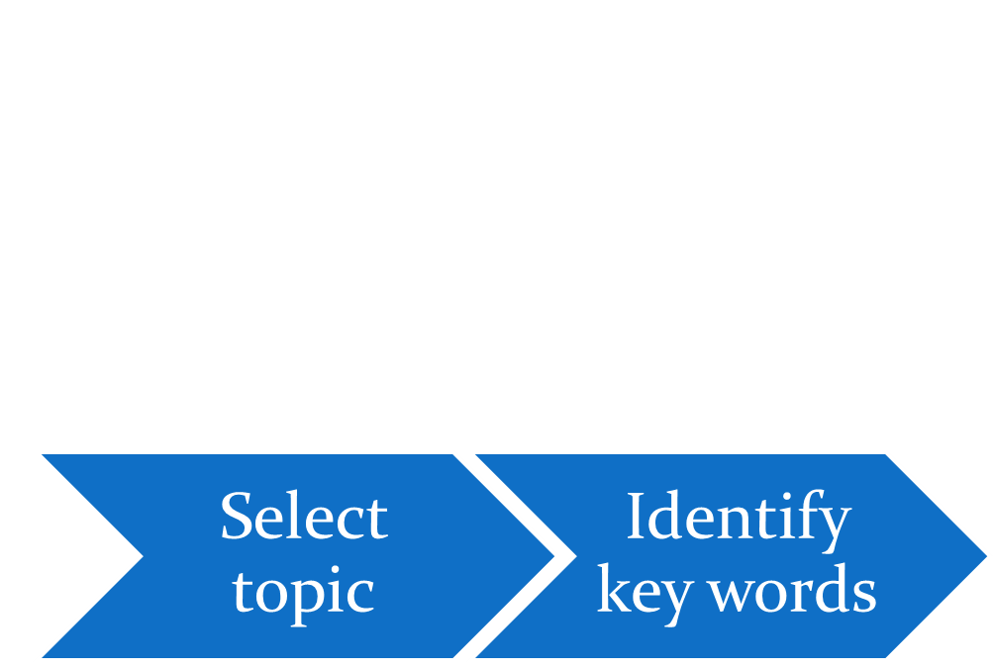
The Writing Process
Once you have selected your topic, identify the key words in the question.

Slide 13
What are key words?
Key words tell you how to answer the question.
Understanding the meaning of these key words is an important first step in essay writing.
You need the right key!

Slide 14
Key words
Assess Comment Compare Consider Justify | Decide to what extent something is true. Persuade the reader by citing relevant evidence. Remember to point out counter-arguments as well. Conclude by stating clearly how far you are in agreement with the idea. Pick out the main points related to the subject and give your opinion, reinforcing your point of view with logical evidence. Identify the similarities and differences between two or more phenomena. Say if any of the shared similarities or differences are more important than others Say what you think and back up your points with appropriate evidence . Give evidence which supports an argument or idea and show why a certain conclusion was made. Also rebut the main objections which are normally made.

Slide 15
Key words
Discuss To what extent/ How far Account for Analyse Evaluate | Write for and against a statement, or point out the advantages and disadvantages . Remember , however, to arrive at a conclusion. Assess all the evidence you have when writing your arguments. A final conclusion, showing how far you are in agreement with the statement is required. Give reasons for; explain why something happens Break up into parts and investigate each part. Weigh arguments for and against something, assessing the strength of the evidence on both sides. Come to a final conclusion, and justify how you made your choice.

Slide 16
Key words on subject matter
Students also need to identify key words related to the subject matter / content of the essay.
Look carefully at the way the question is phrased so you know what approach to use when writing your essay.
Misinterpretation may cause the essay to be out of point.
I didn’t look for key words!
I wrote out of point!

Slide 17
Identifying key words Example 1
Title:
Why do human beings of all ages feel the need to play?
Key words have been highlighted in red.
Why – You need to give reasons in your answer.
Human beings of all ages – You need to discuss by age groups (babies, children, teenagers, the middle-age, the seniors)
Need – You must show why they feel they must play.
If you write an essay about why human beings play, then you will not be answering the question.

Slide 18
Identifying key words Example 2
Title:
To what extent are racism an other forms of discrimination a problem in your society?
To what extent – You can agree completely or partially, but an opinion is needed.
Racism – Issues related to race
Other forms of discrimination – discrimination against gays and homosexuals, discrimination against women, discrimination between the rich and the poor, discrimination against the handicapped, etc.
Your society – If you are Malaysian, then Malaysia
If you write an essay about racism being sometimes a problem in your country and you don’t write about other forms of discrimination, your essay is out of point.

Slide 19
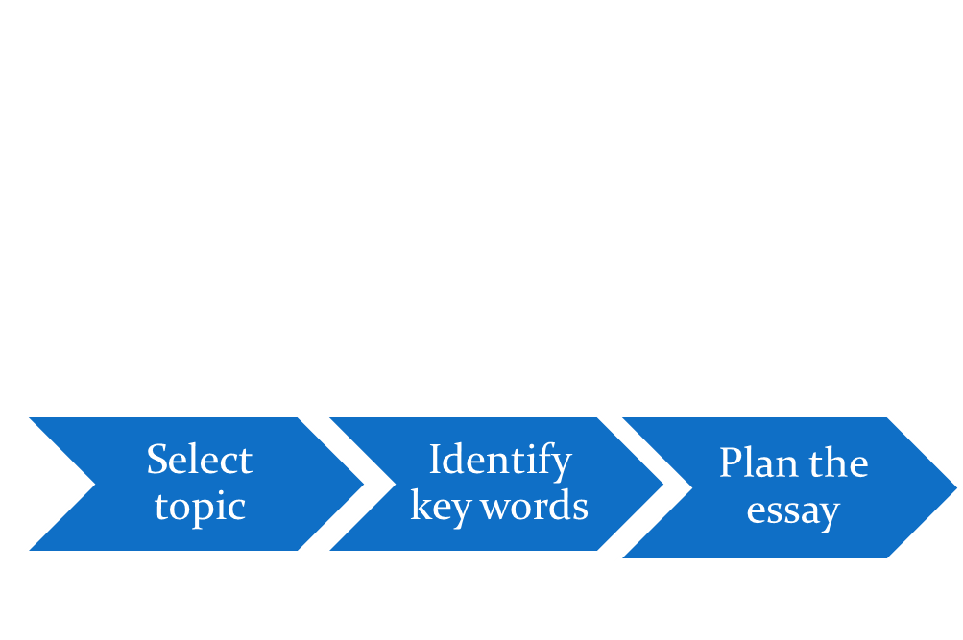
The Writing Process
Now you have selected your topic and identified the key words in the question, formulate a plan before writing.

Slide 20
Planning - Preparing an Outline
An outline is central to writing a good and effective essay.
It acts as a skeleton to your work and plays an important role in planning an essay.
Effective outlining helps one to distinguish the key ideas and establishes a link between the main ideas and the supporting details.
An outline helps you keep focused on answering the question.
You can mind map, or prepare your outline in the form of a list. Use any method you are comfortable with but make sure that you keep the question in mind.
A good plan ensures that you don’t stray from the question.

Slide 21
What is in the outline?
An outline identifies :
The points / arguments you will be covering in your essay. (We will be discussing this in the next chapter)
The main point / argument of every paragraph
Details, examples, evidence to be included to support arguments in each paragraph.
At this planning stage, the focus is on getting ideas

Slide 22
Outline of a G. P. essay
Outline of a G. P. essay comprises the following
An Introductory paragraph
Three to four supporting paragraphs, each covering one point or argument.
A concluding paragraph

Slide 23
Terms
In every Introduction, there is a thesis statement which tells the reader how much you are going to cover in your essay. (This will be covered in Chapter 2)
Every paragraph deals with one point or argument which is summarized in the topic sentence. (This will be discussed in Chapter 3)

Slide 24
G.P. Essay Outlines
The next slide shows a skeletal outline for a G.P. essay.
In order to make sure you get a clear picture, the slide after that is a sample outline for a G.P. essay, with a title, etc.

Slide 25
Sample Structure of an Essay Outline
Title: ________________________________________________________________________________________ Introduction Introductory statement Thesis statement: ____________________ Body First Supporting Argument /Idea (Topic Sentence): ____________________ Examples, evidence____________________ Examples, evidence____________________ Examples, evidence____________________ Second Supporting Argument /Idea (Topic Sentence): ____________________ Examples, evidence____________________ Examples, evidence____________________ Third Supporting Argument/ Idea (Topic Sentence): ____________________ Examples, evidence____________________ Examples, evidence____________________ Examples, evidence____________________ Conclusion Closing statement Restate thesis, look into the future, ____________________

Slide 26
Example of Scratch Outline : Title: Does the television have real benefits?
Thesis statement: Television keeps us entertained and up-to-date, is educational and widens our horizons
1. Entertainment
a. Movies – help one relax and reduce stress. Examples of comedies, etc.
b. Sports, etc. keeps fans occupied; they stay away from unhealthy activities. World Cup, golf tournaments, etc.
2. Keeps us up-to-date
a. News channels like CNN and BBC- keep us updated about current political situations and natural disasters, etc.
b. Business channels like CNBC tell us of current market movements, and everything related to business e.g. mergers, bankruptcies,
3. Educational
a. Children’s shows and educational programs
b. Health programs
4. Widens our horizons
a. Allows us to see what we otherwise would never see – animals, etc.
b. Introduces us to other cultures – Discovery, Travel and Adventure, food.
Conclusion:
Although television may bring negative side effects, it obviously brings real benefits which far outweigh the disadvantages………

Slide 27
Activity for Chapter 1
Please go to Activity 1 and identify key words in the essay topics given.

